Slide 1
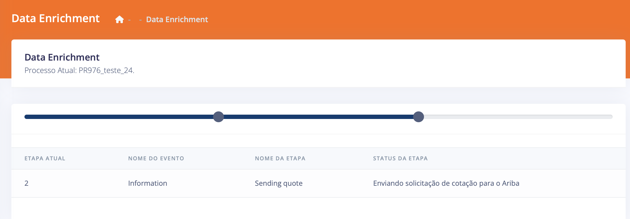

CONSTELLATION ORION BY STRATESYS
Stratesys cloud platform that integrates, concentrates and consolidates data from SAP ARIBA, SAP ERP and tax rules, transforming data into valuable information for use in decision-making and execution of processes that systems alone cannot obtain.
Data Enrichment is a service created to meet the process needs of the Ariba platform, and together with SMART MAP it leverages SAP Ariba solutions
In a requisition creation process in the Ariba Buying module, several customers highlighted the need to enrich information during the process of creating a quotation through a requisition.
The procedural limitation that led to the creation of the service was the fact that the Ariba Buying module transits only a few selected fields when converting a requisition to a quote in the Ariba Sourcing module and vice versa. This functionality of Ariba Buying is called Full Sourcing Project.
Most of the customers who contacted us, demanded to transfer information from custom fields created in the requisition to the quotation and from the quotation to the requisition, thus, Data Enrichment appears to solve this problem.
With the use of the Data Enrichment fix process, customers are now able to transact the fields they want without having to restrict their information, in addition to facilitating the purchase flow for requester and buyers.
Chronys
is an
u-intelligent buy
Feature/Module
Usability – Integration
Ariba x Chronys SMART MAP
More details in a specific proposal related to the Map's RFP

Slide 2


CONSTELLATION ORION BY STRATESYS
Benefits
Data Enrichment via Chronys is used as a standard implementation of best practices created through our experiences on projects where we address specific needs regarding field transition and approval control.
This add on can be additionally purchased individually as a SaaS product.
And when you hire Smart Map by Stratesys, this add on will already be part of the product.
Convert Request to Quotation
Quotation to Requisition Conversion
Approval
Requisition Creation
Quotation Creation
Award
Requisition Update
Approves the Requisition
Chronys
is an
u-intelligent buy
Feature/Module
More details in a specific proposal related to the Map's RFP

